Slide 1

Drama At Cornwallis Academy
Year 8 – LESSON 2
Lesson Objective:
-To continue to demonstrate an understanding of how show a character
- To understand the importance of reacting instantly to instructions when developing group improvisation.
WILF:
Performing and Creating Success Criteria
Level 3
I can sustain a role that I have created for some of the performance. I am more comfortable being led by others in a group situation.
Level 4
I can stay in role for good parts of my performance, occasionally struggling to keep focused. I will make a reasonable contribution to my groups work, sharing some simple ideas.
Level 5
I can stay in role for most of the performance with few distractions. I will make a positive contribution to a group, sharing ideas and showing some leadership.
Level 6
I can consistently stay in role for the whole of the performance. I Contribute ideas very well to the group I’m in and am capable of showing good leadership skills

Slide 2
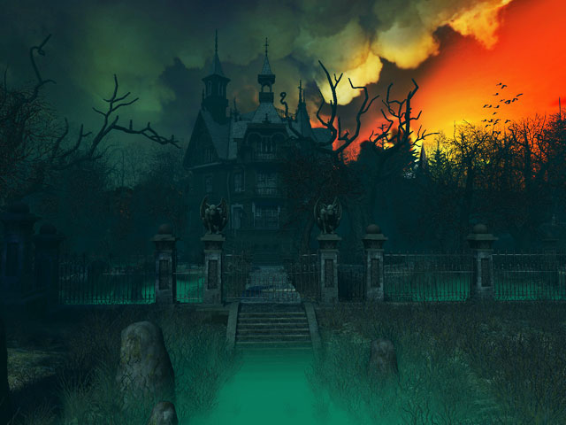
Lesson Objective:
-To continue to demonstrate an understanding of how show a character
- To understand the importance of reacting instantly to instructions when developing group improvisation. . .
Activity 1 – Murder Mystery game 2 – Who is the murderer? What skills did you use here?
Success Criteria
Creating and Performing
Level 3
I can sustain a role that I have created for some of the performance. I am more comfortable being led by others in a group situation.
Level 4
I can stay in role for good parts of my performance, occasionally struggling to keep focused. I will make a reasonable contribution to my groups work, sharing some simple ideas.
Level 5
I can stay in role for most of the performance with few distractions. I will make a positive contribution to a group, sharing ideas and showing some leadership.
Level 6
I can consistently stay in role for the whole of the performance. I Contribute ideas very well to the group I’m in and am capable of showing good leadership skills
Notes:
Use youtube to play the clip. Type in Murder Mystery Game 2. The answer can be found on the link below.

Slide 3
Mystery Manor House
Lesson Objective:
-To continue to demonstrate an understanding of how show / develop a character.
- To understand the importance of reacting instantly to instructions when developing group improvisation. .
Success Criteria:
Level 3
I can sustain a role that I have created for some of the performance. I am more comfortable being led by others in a group situation.
Level 4
I can stay in role for good parts of my performance, occasionally struggling to keep focused. I will make a reasonable contribution to my groups work, sharing some simple ideas.
Level 5
I can stay in role for most of the performance with few distractions. I will make a positive contribution to a group, sharing ideas and showing some leadership.
Level 6
I can consistently stay in role for the whole of the performance. I Contribute ideas very well to the group I’m in and am capable of showing good leadership skills
Notes:
Play scary music

Slide 4
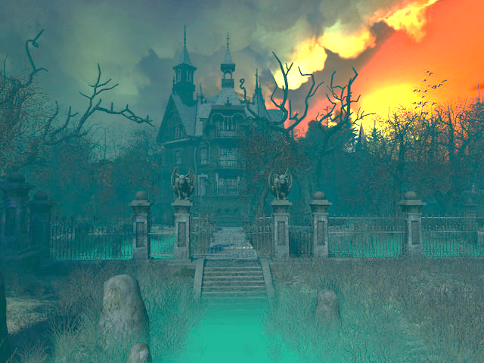
LESSON OBJECTIVE:
-To continue to demonstrate an understanding of how show / develop a character
- To understand the importance of reacting instantly to instructions when developing group improvisation.
Warm –up
Creating reactions – You are to walk around the space and immediately react to instructions. These reactions will be based around your relationships with others. (For example, boys are scared of all girls, girls are angry with the boys. You are to show this only through facial expressions and body language)
SUCCESS CRITERIA:
Creating and Performing
Level 3
I can sustain a role that I have created for some of the performance. I am more comfortable being led by others in a group situation.
Level 4
I can stay in role for good parts of my performance, occasionally struggling to keep focused. I will make a reasonable contribution to my groups work, sharing some simple ideas.
Level 5
I can stay in role for most of the performance with few distractions. I will make a positive contribution to a group, sharing ideas and showing some leadership.
Level 6
I can consistently stay in role for the whole of the performance. I Contribute ideas very well to the group I’m in and am capable of showing good leadership skills

Slide 5

Recap - What did you learn in the previous lesson about demonstrating a character? - What do you need to improve on to make your character more believable?
(You will need to write your answers on your mini whit boards. You will need to refer back to this at the end of the lesson to see if you have improved.)
TASK 1
You will now repeat entering the Manor House and rehearsing in your small groups where you are going to sleep, what you are going to do with no electricity and what you are going to do about not being able to get in contact with Mrs Harvey. 7 Minutes
(What will you need to think about? What are the health and safety cautions?)
Mystery Manor House
Success Criteria:
-To continue to demonstrate an understanding of how show / develop a character.
- To understand the importance of reacting instantly to instructions when developing group improvisation. .
Lesson Objective:
Level 3
I can sustain a role that I have created for some of the performance. I am more comfortable being led by others in a group situation.
Level 4
I can stay in role for good parts of my performance, occasionally struggling to keep focused. I will make a reasonable contribution to my groups work, sharing some simple ideas.
Level 5
I can stay in role for most of the performance with few distractions. I will make a positive contribution to a group, sharing ideas and showing some leadership.
Level 6
I can consistently stay in role for the whole of the performance. I Contribute ideas very well to the group I’m in and am capable of showing good leadership skills
Notes:
Line students up outside the room. Set the classroom up a scary as you can. Turn lights off, play scary music etc…
Using the attached resources you will need to give out instructions to students as the lesson goes on. They will need to be in character at all times. People will need to die and you will need to plant the person you choose to be the murder, near the deaths. However be careful not to make it too obviously. Have other suspects. Each time everyone dies question a variety of people until you also end up questioning the same 3/4 people. Try and instruct at least 3 people to die. Students needs to stay in character and use the classroom space to imagine they are exploring the manor house.

Slide 6
LESSON OBJECTIVE:
-To continue to demonstrate an understanding of how show / develop a character.
- To understand the importance of reacting instantly to instructions when developing group improvisation. .
Mystery Manor House
Strange things will start to happen!
-It is vital that you do what you are instructed to do.
-If you receive an instruction, you must carry it out immediately without questioning it.
SUCCESS CRITERIA:
Level 3
I can sustain a role that I have created for some of the performance. I am more comfortable being led by others in a group situation.
Level 4
I can stay in role for good parts of my performance, occasionally struggling to keep focused. I will make a reasonable contribution to my groups work, sharing some simple ideas.
Level 5
I can stay in role for most of the performance with few distractions. I will make a positive contribution to a group, sharing ideas and showing some leadership.
Level 6
I can consistently stay in role for the whole of the performance. I Contribute ideas very well to the group I’m in and am capable of showing good leadership skills
Notes:
START GIVEN OUT INSTRUCTION TO STRUDENTS.

Slide 7
LESSON OBJECTIVE:
-To continue to demonstrate an understanding of how show / develop a character.
- To understand the importance of reacting instantly to instructions when developing group improvisation. .
Mystery Manor House
TASK 2
As a class you will now need to act out going to sleep etc… What things do you need to think about? Remember to stay in character at all times.
What skills have you needed to use so far? How do these help you develop a character? How can these skills be used in the world of work?
10 minutes
SUCCESS CRITERIA:
Level 3
I can sustain a role that I have created for some of the performance. I am more comfortable being led by others in a group situation.
Level 4
I can stay in role for good parts of my performance, occasionally struggling to keep focused. I will make a reasonable contribution to my groups work, sharing some simple ideas.
Level 5
I can stay in role for most of the performance with few distractions. I will make a positive contribution to a group, sharing ideas and showing some leadership.
Level 6
I can consistently stay in role for the whole of the performance. I Contribute ideas very well to the group I’m in and am capable of showing good leadership skills

Slide 8
LESSON OBJECTIVE:
-To continue to demonstrate an understanding of how show / develop a character.
- To understand the importance of reacting instantly to instructions when developing group improvisation. .
Mystery Manor House
TASK 3
You will now be put into new groups. In rooms that night you start to introduce yourselves when murders begin to happen. This is all acted out. It is a good opportunity for you to allow your character to come to life.
- How is this task linked to the LO and Success Criteria?
7 minutes
SUCCESS CRITERIA:
Level 3
I can sustain a role that I have created for some of the performance. I am more comfortable being led by others in a group situation.
Level 4
I can stay in role for good parts of my performance, occasionally struggling to keep focused. I will make a reasonable contribution to my groups work, sharing some simple ideas.
Level 5
I can stay in role for most of the performance with few distractions. I will make a positive contribution to a group, sharing ideas and showing some leadership.
Level 6
I can consistently stay in role for the whole of the performance. I Contribute ideas very well to the group I’m in and am capable of showing good leadership skills

Slide 9
LESSON OBJECTIVE:
-To continue to demonstrate an understanding of how show / develop a character.
- To understand the importance of reacting instantly to instructions when developing group improvisation. .
Mystery Manor House
TASK 4 - Murder Investigation
-Did anyone see anything, had the victim been acting strangely? (Once you are dead you can help the teacher)
-You will now need to get sat in a circle. This is now a chance to call people to the hot seat to try and work out who the murderer is. Only the murderer may lie.
-Ghosts/ victims can be hot seated. Question idea: Is it true that you were interested in purchasing the property? Do you believe that the property is haunted?
-Can you find any link between the murders? - Suspects are interviewed – Someone is arrested – Murderer reveals themselves last when finally instructed to.
SUCCESS CRITERIA:
Level 3
I can sustain a role that I have created for some of the performance. I am more comfortable being led by others in a group situation.
Level 4
I can stay in role for good parts of my performance, occasionally struggling to keep focused. I will make a reasonable contribution to my groups work, sharing some simple ideas.
Level 5
I can stay in role for most of the performance with few distractions. I will make a positive contribution to a group, sharing ideas and showing some leadership.
Level 6
I can consistently stay in role for the whole of the performance. I Contribute ideas very well to the group I’m in and am capable of showing good leadership skills
Notes:
Pick your suspects to interview and as a group interview them and get student to vote on a murderer. Only after this has happened and someone has been arrested should the murderer real themselves. Whoever you choose in secret to be the murderer must understand that they need to keep it a secret. Try and talk to lots of different students so that it is not obvious. Using the resources hand out other tasks to other students.

Slide 10
LESSON OBJECTIVE:
-To continue to demonstrate an understanding of how show / develop a character.
- To understand the importance of reacting instantly to instructions when developing group improvisation. .
Mystery Manor House
TASK 5
Questions and Answers
In order for a Murder Mystery to work successfully what must happen and why?
Why is characterisation so important with Murder Mystery?
What level have you achieved today? How?
What do you need to do to achieve the next level?
10 minutes
SUCCESS CRITERIA:
Level 3
I can sustain a role that I have created for some of the performance. I am more comfortable being led by others in a group situation.
Level 4
I can stay in role for good parts of my performance, occasionally struggling to keep focused. I will make a reasonable contribution to my groups work, sharing some simple ideas.
Level 5
I can stay in role for most of the performance with few distractions. I will make a positive contribution to a group, sharing ideas and showing some leadership.
Level 6
I can consistently stay in role for the whole of the performance. I Contribute ideas very well to the group I’m in and am capable of showing good leadership skills

